Slide 1
MULTI-CUT REBAR(10)
Advisor : Prof. K.C.Chang
Presenters : You-Ran Nai

Slide 2
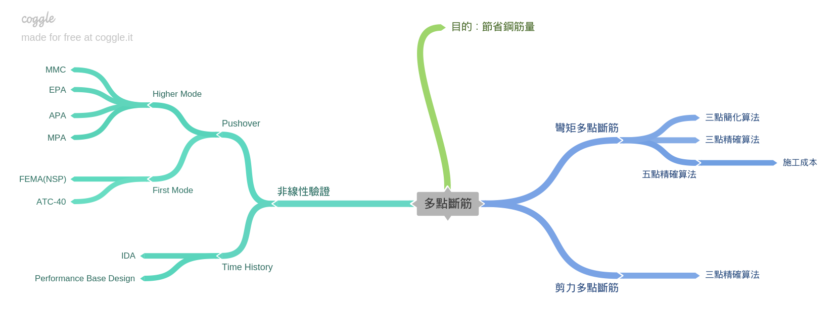
Roadmap

Slide 3
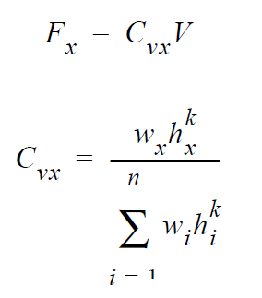
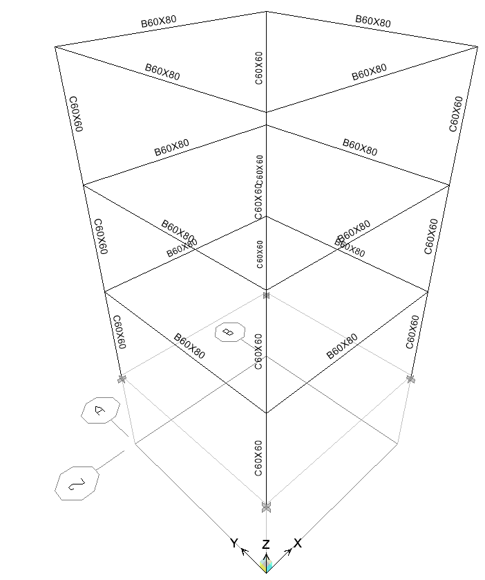
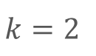
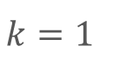
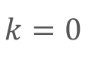
FEMA Load Pattern
$$k=0$$
$$k=1$$
$$k=2$$
Notes:
Pushover k=0, 1, 2

Slide 4
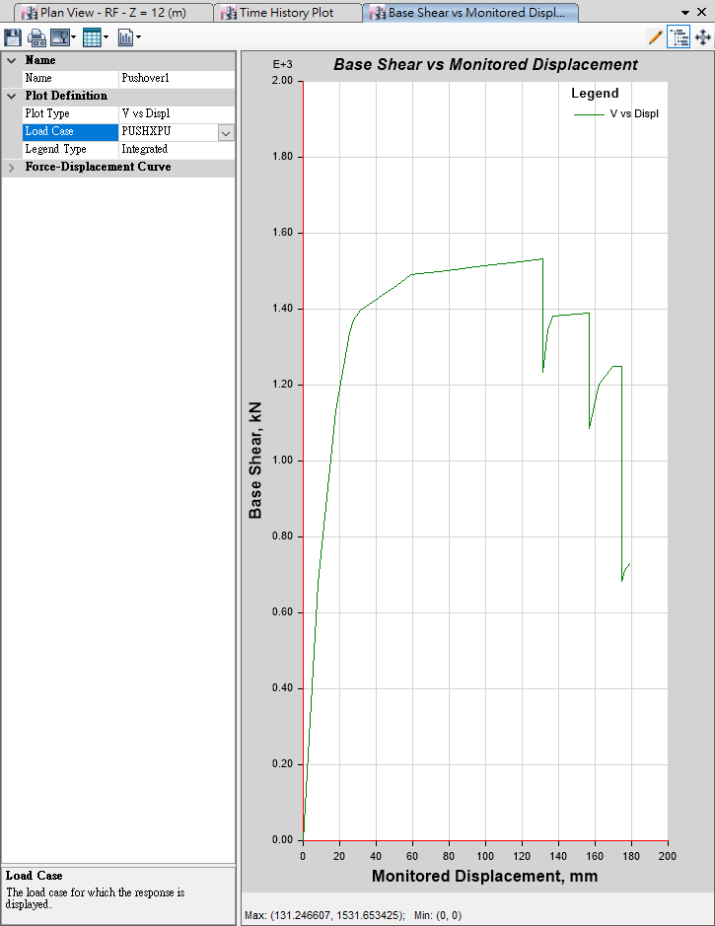
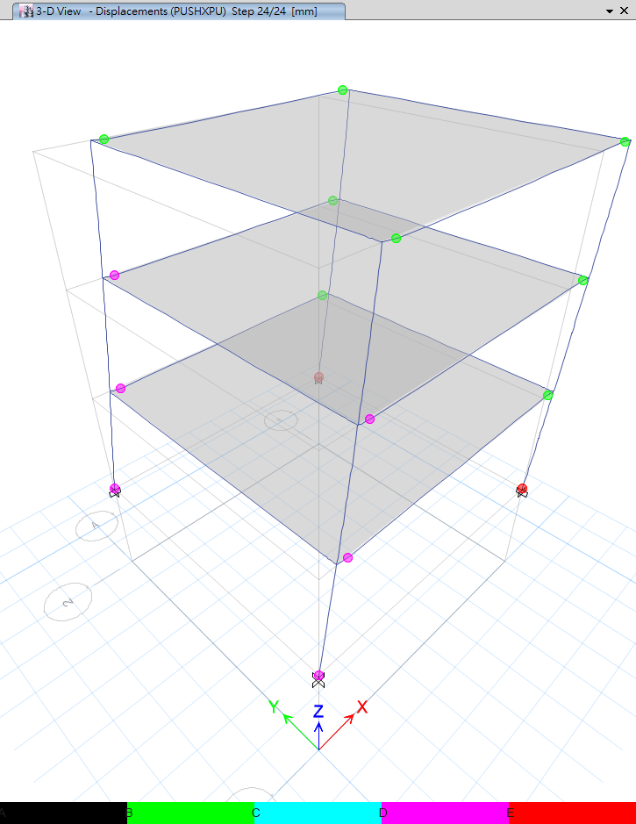
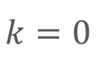
Max Base Shear: 1532kN
Max Disp: 131mm
$$k=0$$

Slide 5
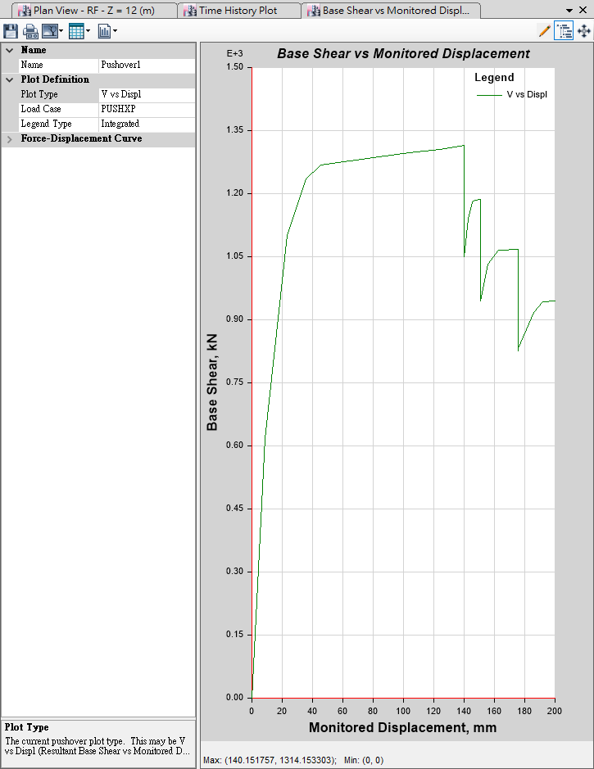
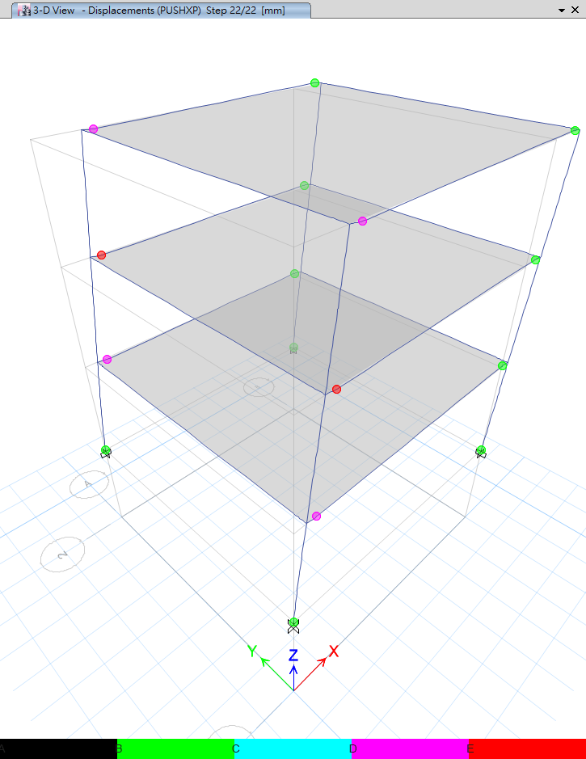
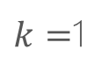
Max Base Shear: 1314kN
Max Disp: 140mm
$k=$1

Slide 6
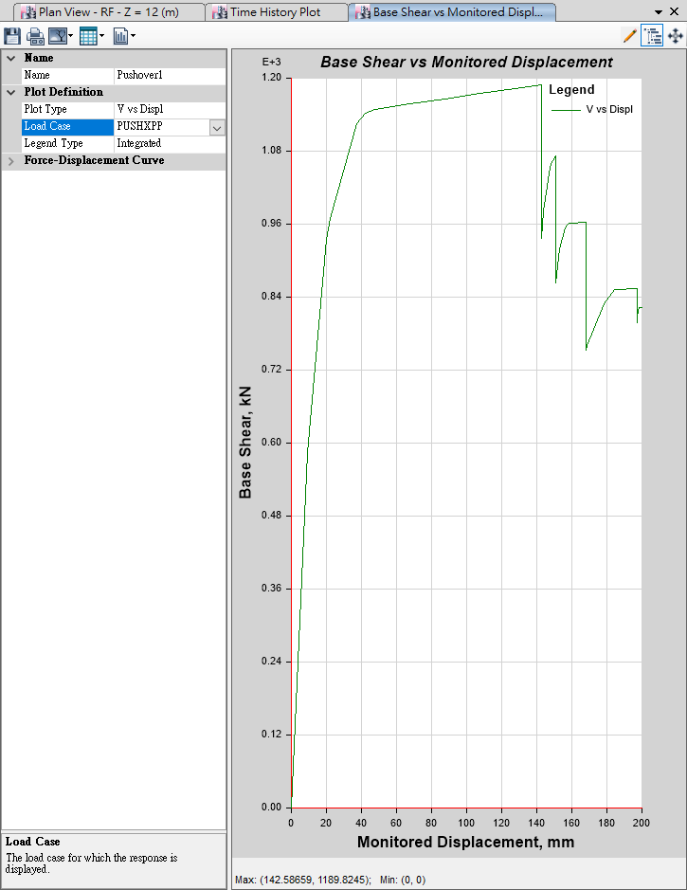

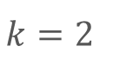
Max Base Shear: 1190kN
Max Disp: 143mm
$$k=2$$

Slide 7
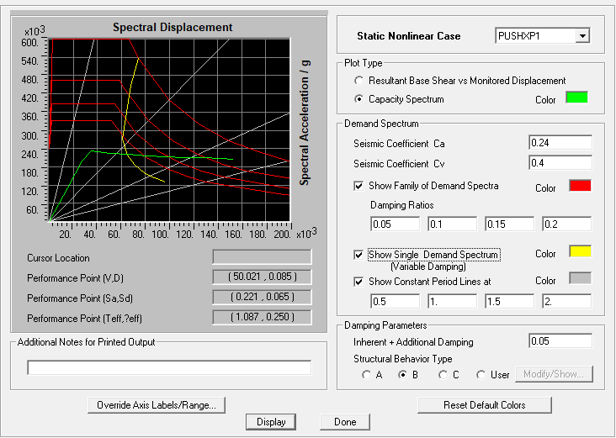
ATC-40 Procedure B

Slide 8
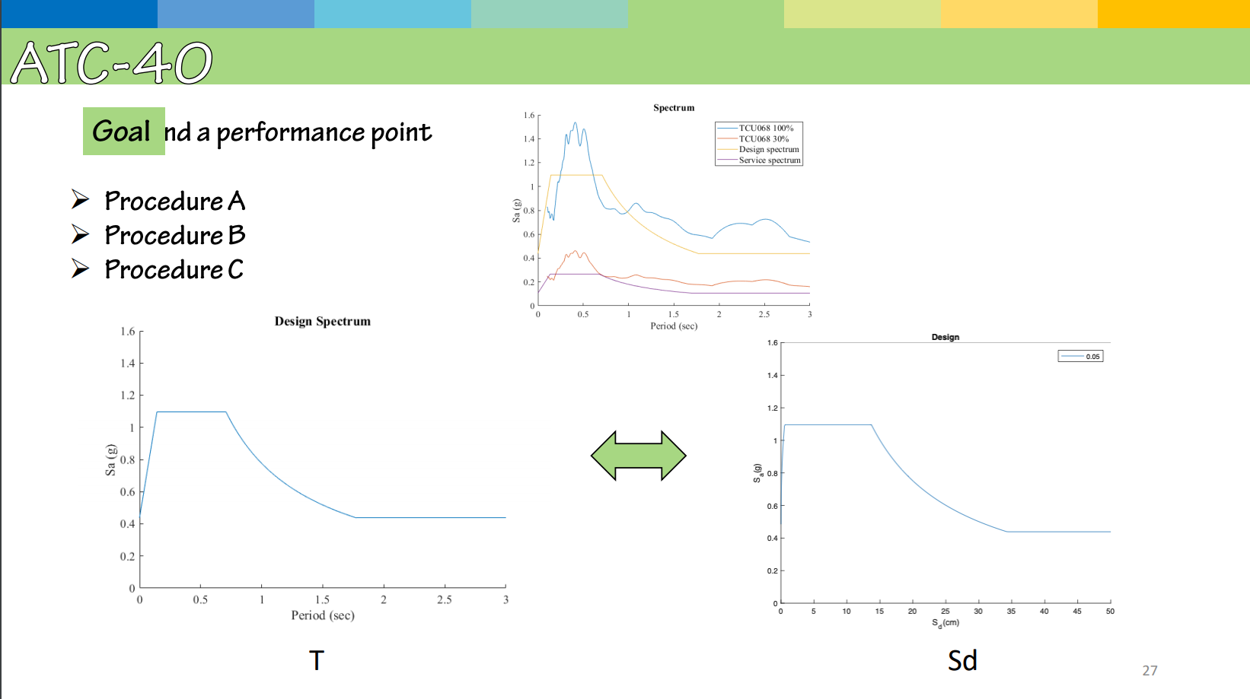

Slide 9
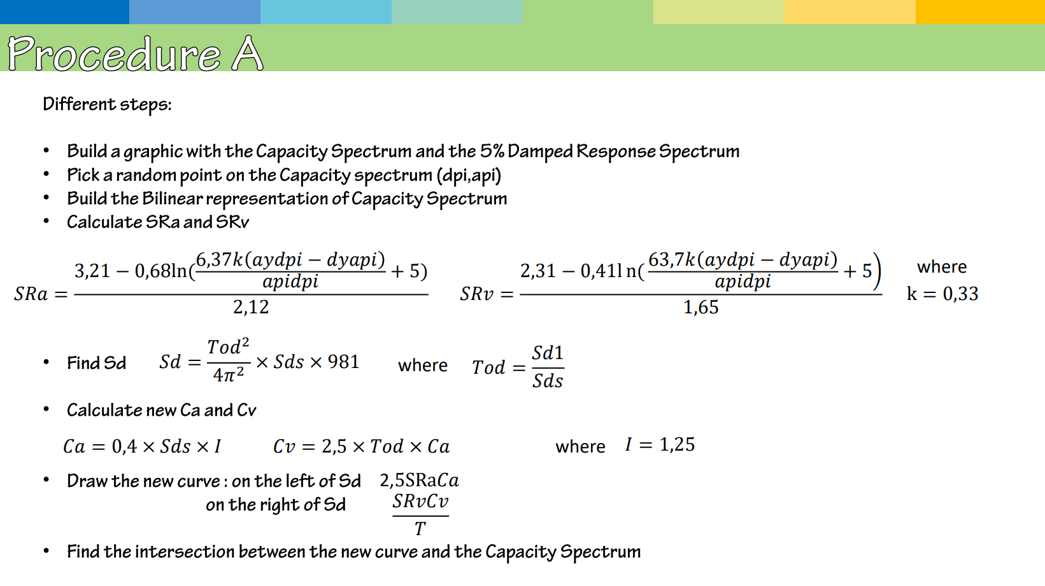

Slide 10
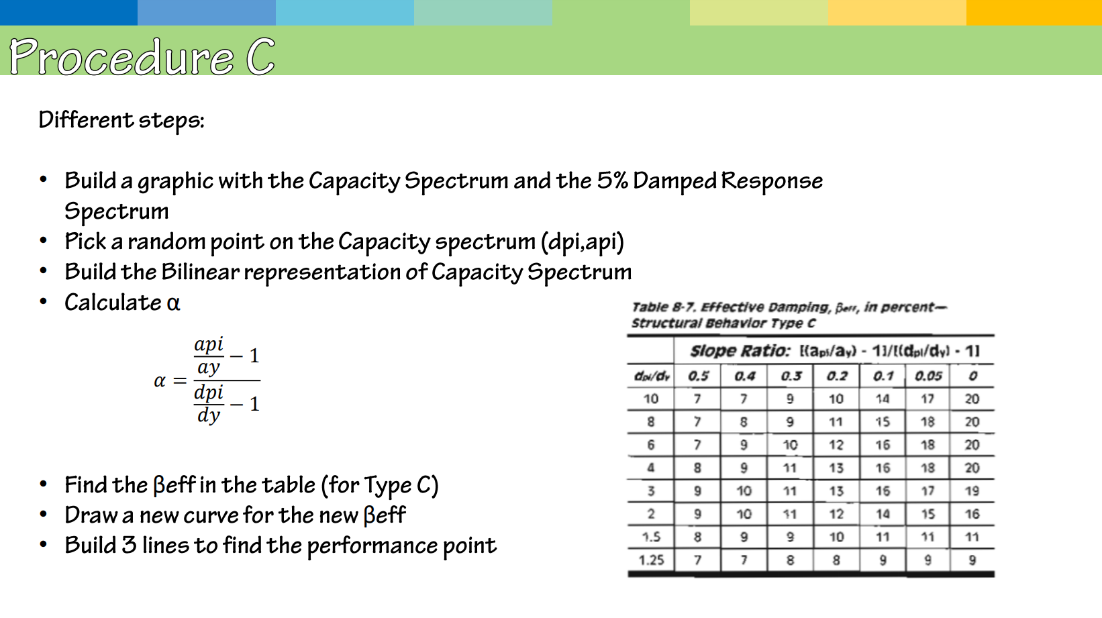

Slide 11
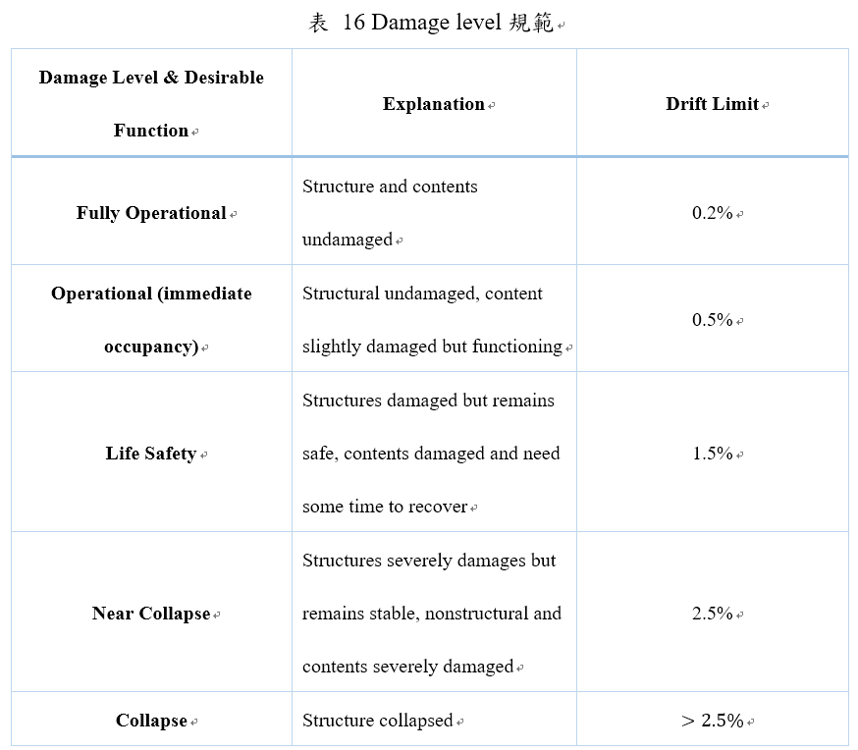

Slide 12
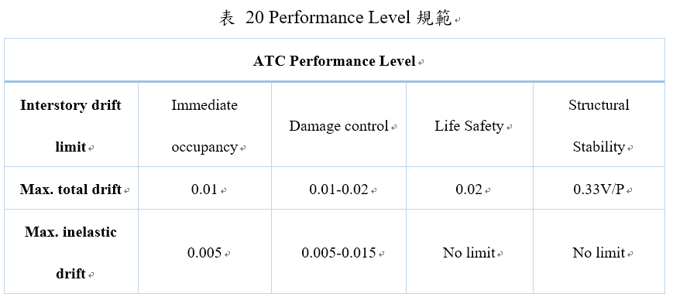
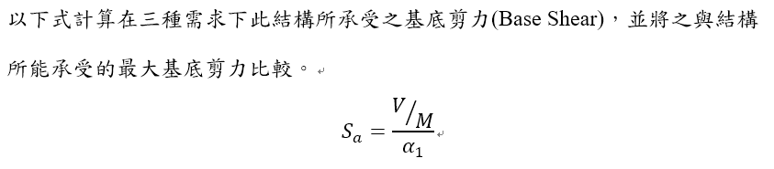

Slide 13
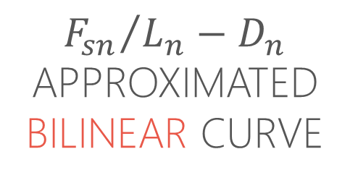
ERRORS ARISE
ASSUMPTIONS AND APPROXIMATIONS
NEGLECT YIELDING COUPLE
SUPERPOSITION OF RESPONSES VALID LINEARLY ELASTIC
$${F_{sn}}/{L_{n}−D_{n}}$$
APPROXIMATED BILINEAR CURVE

Slide 14
ELASTIC BUILDINGS
MODAL RESPONSE HISTORY ANALYSIS
MODAL RESPONSE SPECTRUM ANALYSIS
MODAL PUSHOVER ANALYSIS

Slide 15
INELASTIC BUILDINGS
RESPONSE HISTORY ANALYSIS
UNCOUPLED MODAL RESPONSE HISTORY ANALYSIS
MODAL PUSHOVER ANALYSIS

Slide 16
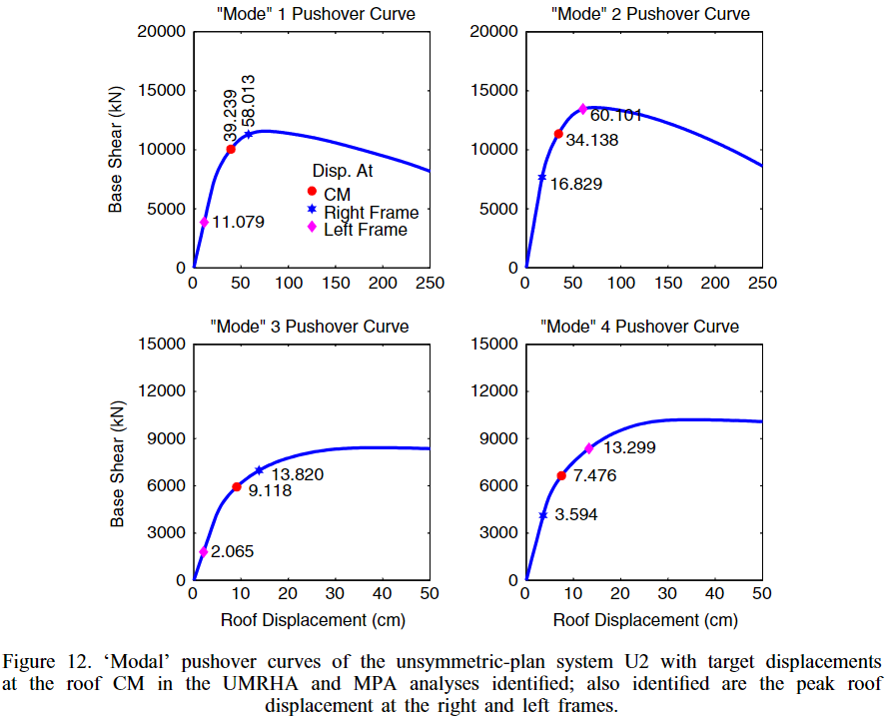
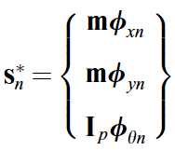
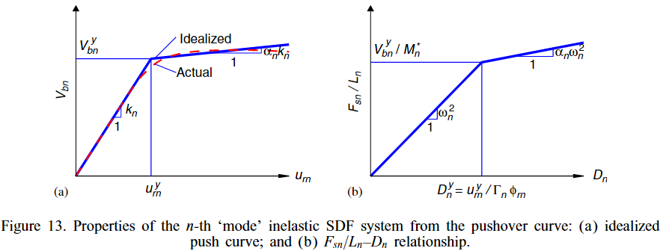
MPA
MODAL FORCE DISTRIBUTION
MODAL COMBINATION RULE
CQC

Slide 17
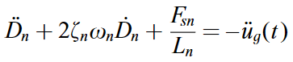
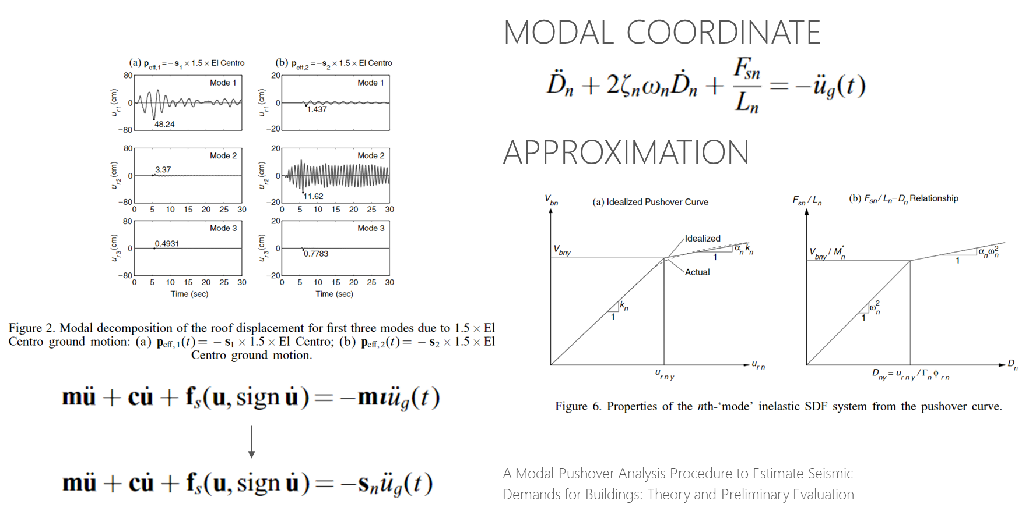
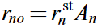
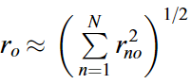
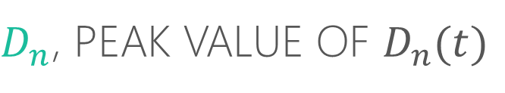
MPA
$D_{n}$, PEAK VALUE OF $D_{n}(t)$
RESPONSE (OR DESIGN) SPECTRUM
SRSS CQC

Slide 18
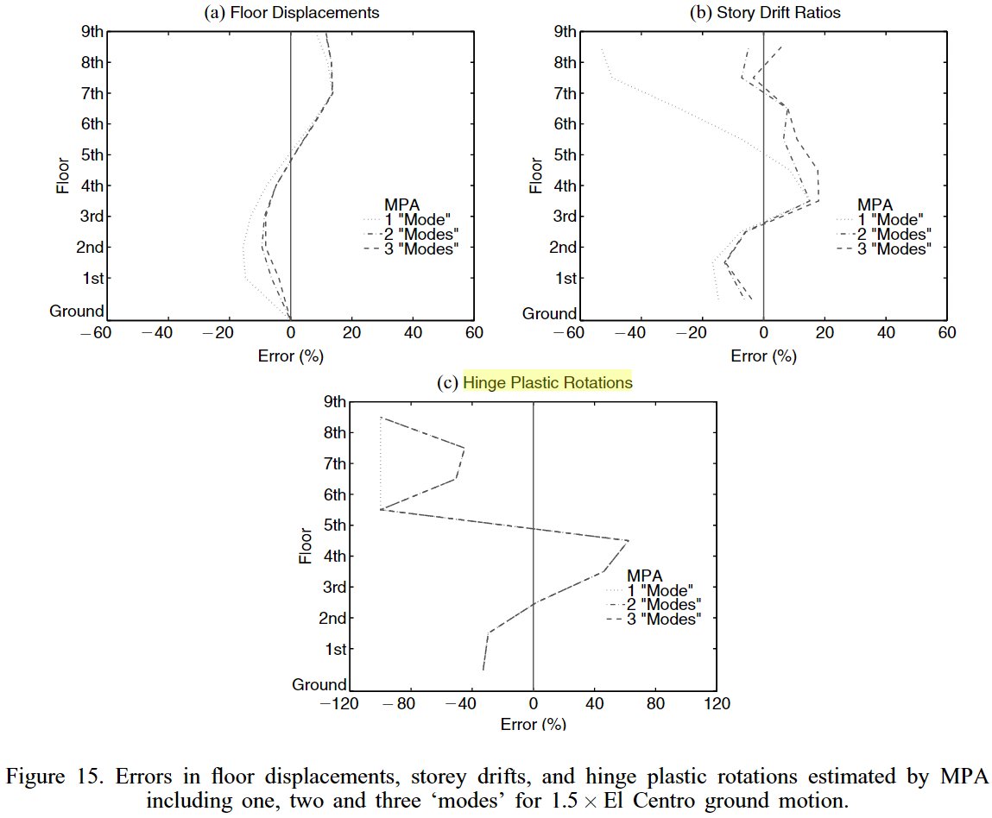
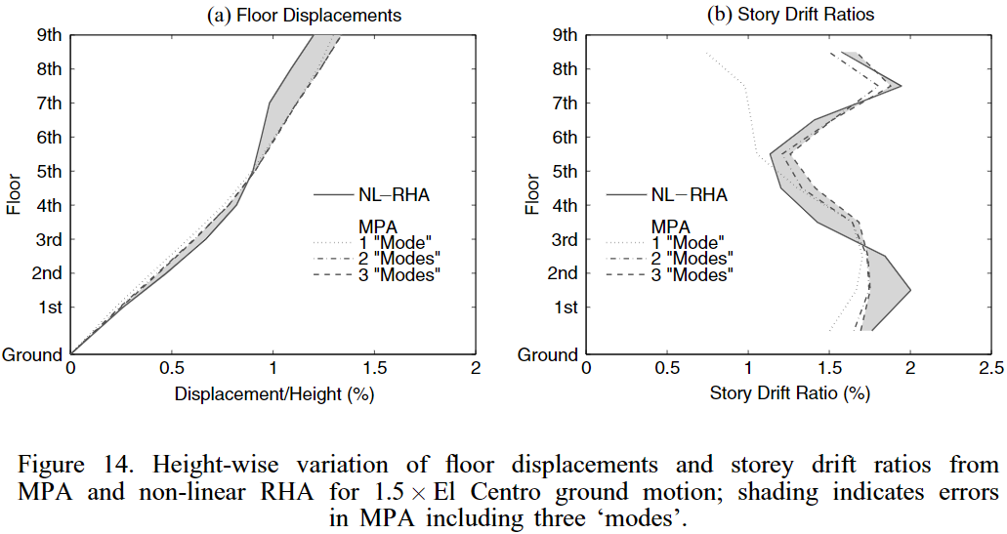
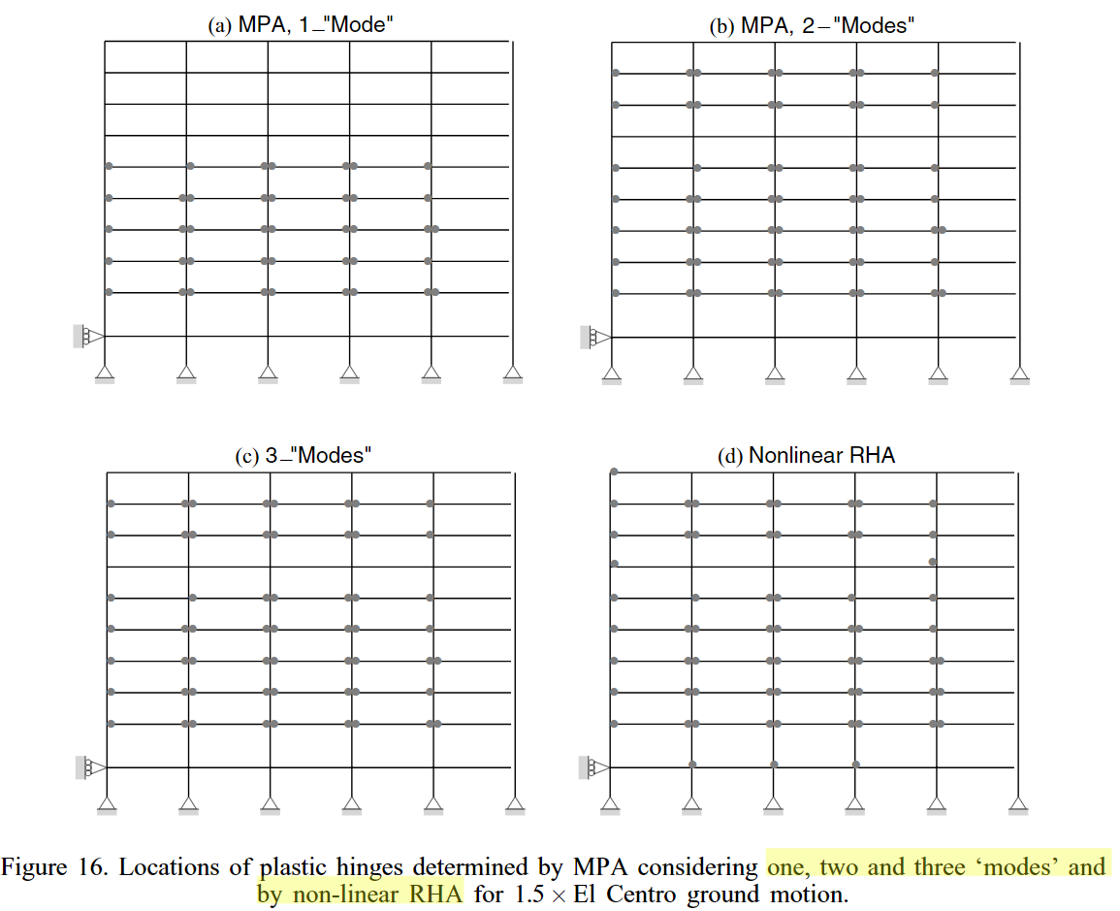
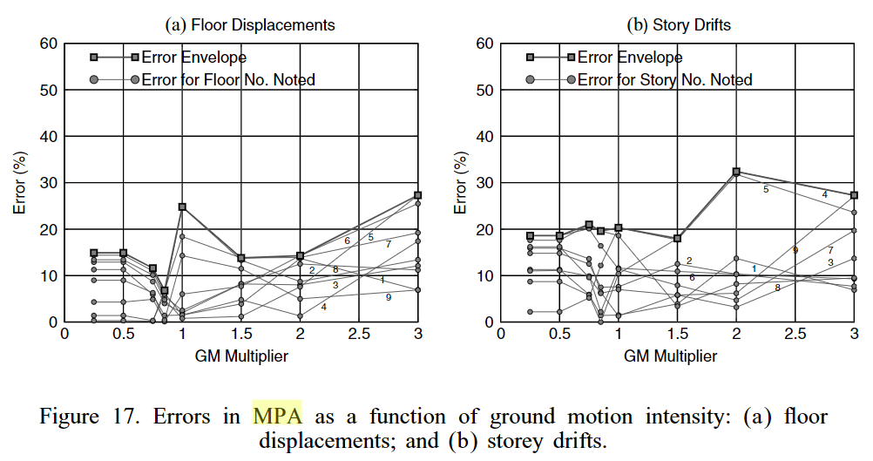

Slide 19
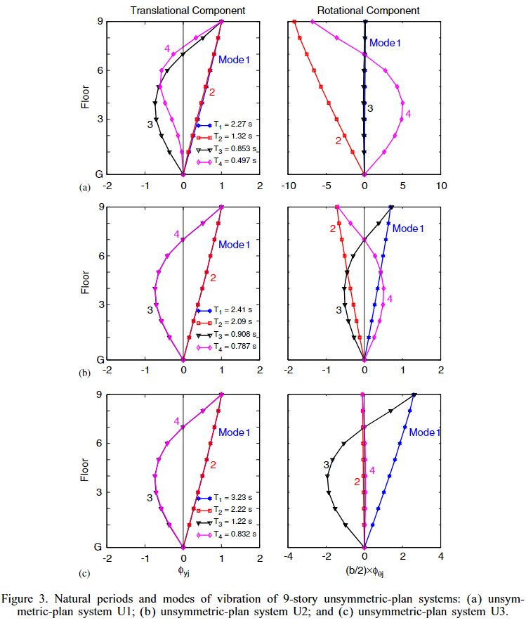
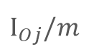

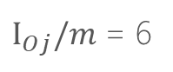
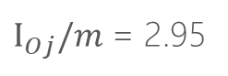
TORSIONALLY-STIFF
$$I_{Oj}/m$$
LATERAL > TORSIONAL
TORSIONALLY-SIMILARLY-STIFF
FIRST TWO MODES CLOSE
$I_{Oj}/m$ = 2.95
LATERAL $≅$ TORSIONAL
TORSIONALLY-FLEXIBLE
$I_{Oj}/m$ = 6
LATERAL < TORSIONAL

Slide 20
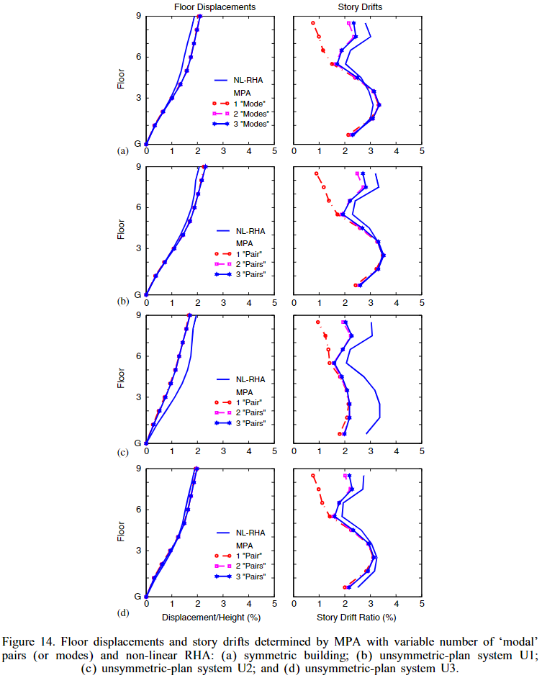
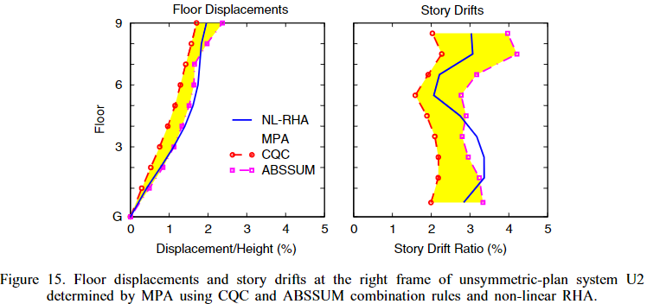
SYMMETRIC
U1
U2
CQC UNDER-ESTIMATION
U3

Slide 21
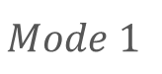
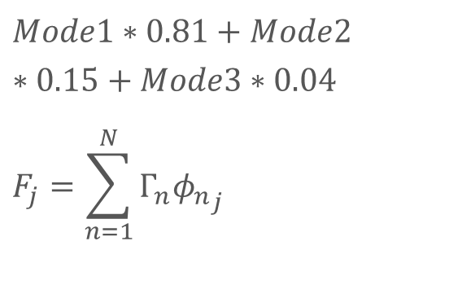
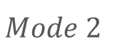
Mode Pushover
0.525
-0.319
0.427
$$Mode1∗0.81+Mode2∗0.15+Mode3∗0.04$$
$$F_{j}=\sum_{n=1}^{N}{Γ_{n}{φ_{n}}_{j}}$$
0.343
0.321
0.402
0.132
0.359
0.171
$$Mode 1$$
$$Mode 2$$
MMC
Notes:
Pushover mode 1, 2, MMC
柱產生塑角

Slide 22
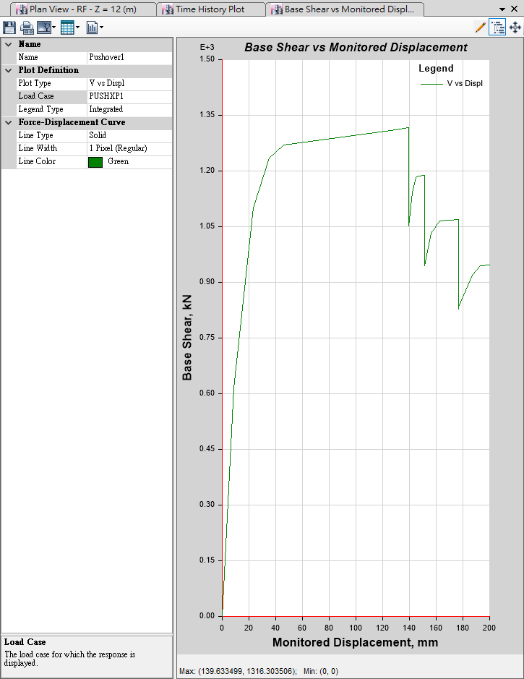

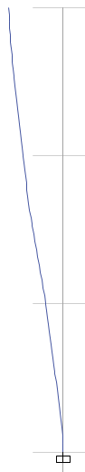
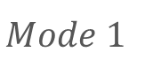
Max Base Shear: 1316kN
Max Disp: 140mm
$$Mode 1$$

Slide 23
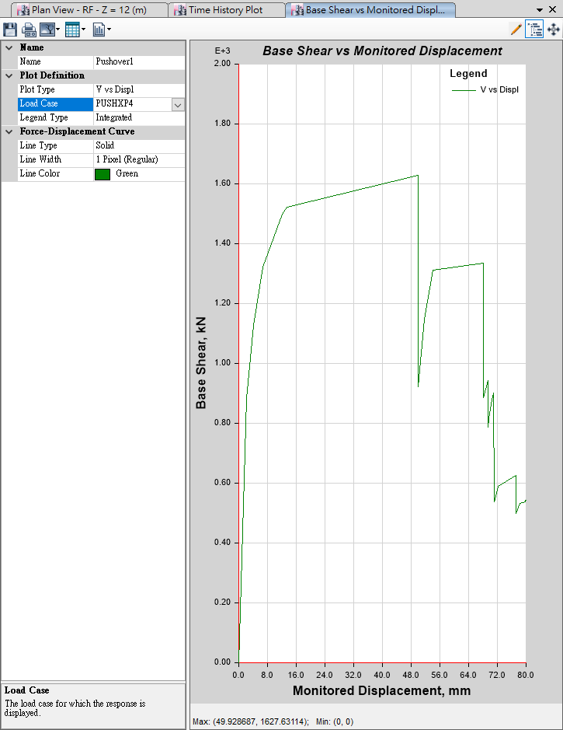
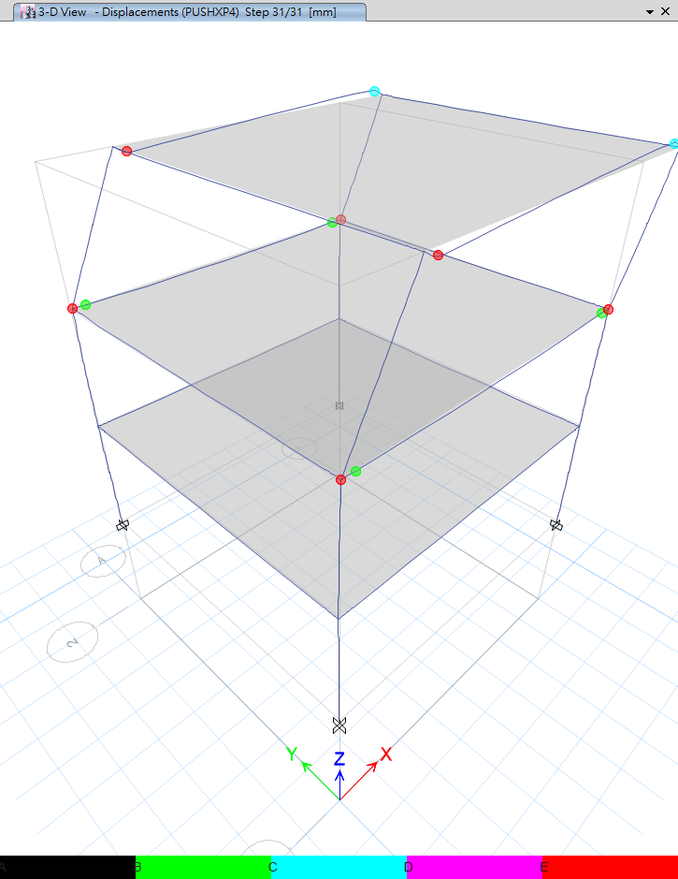
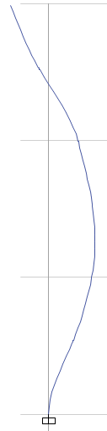
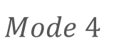
Max Base Shear: 1627kN
Max Disp: 50mm
$$Mode 4$$

Slide 24



Max Base Shear: 558kN
Max Disp: 109mm
MMC:
$$Mode1∗0.85+Mode4∗0.11$$
$$F_{j}=\sum_{n=1}^{N}{Γ_{n}{φ_{n}}_{j}}$$

Slide 25





T=0.345
T=0.752
No Nonlinear Beam Hinge
Nonlinear Beam Hinge

Slide 26



P-Delta
Local Buckling

Slide 27
921 TAP010
Notes:
擬合反應譜 圖
結果
IDA

Slide 28

Notes:
線性 7.2mm
Sotry drift 0.001

Slide 29


Slide 30


INTRODUCTION
SINGLE STATIC ANALYSIS
➔
INCREMENTAL SPO
SINGLE TIME-HISTORY ANALYSIS
➔
INCREMENTAL ONE

Slide 31

INFINITY
SOFTENS
0.2g
？
SOFTENING
&
HARDENING
EQUAL DISPLACEMENT
0.2g
Notes:
SOME GENERAL PROPERTIES

Slide 32




EARLIER YIELDING
FUSE
STRUCTURAL RESURRECTION

Slide 33

SCALING LEGITIMACY
ROOF DUCTILITY RESPONSE OF A
T₁= 1s
MDOF STEEL FRAME SUBJECTED TO
20 RECORDS
SCALED TO 5 LEVELS OF Sa(T₁,5%)

Slide 34

NON-LINEAR SPO
ELASTIC
➔
MATCH
NON-NEGATIVE
➔
EQUAL DISPLACEMENT
NEGATIVE
➔
SOFTENING

Slide 35

NON-LINEAR SPO
NEGATIVE => NON-NEGATIVE
NEW
EQUAL DISPLACEMENT
➔

Slide 36


Step 28
Step 31

Slide 37


Step 35
Step 58

Slide 38


PGA vs First Mode

Slide 39

Normal vs Multi

Slide 40


Next to Do

Slide 41


